Slide 1

Neural Lyric Transcriber
End-to-End Lyrics Transcription from Mixed Music Audio Using Deep Learning
Presented by: Gideon Szamet
Course: Deep Learning – Technion, 2025
Submission Date: July 24, 2025

Slide 2

Problem Statement
Automatic Speech Recognition (ASR) models perform poorly when transcribing sung lyrics from real musical recordings
What makes it challenging?
🎸 Background instrumentation masks vocals
🎤 Overlapping or multi-layered vocals
🎛️ Vocal effects (reverb, autotune, delay)
🎶 Pitch variation (melody vs monotone speech)
🎼 Irregular rhythm and stretched phonemes

Slide 3
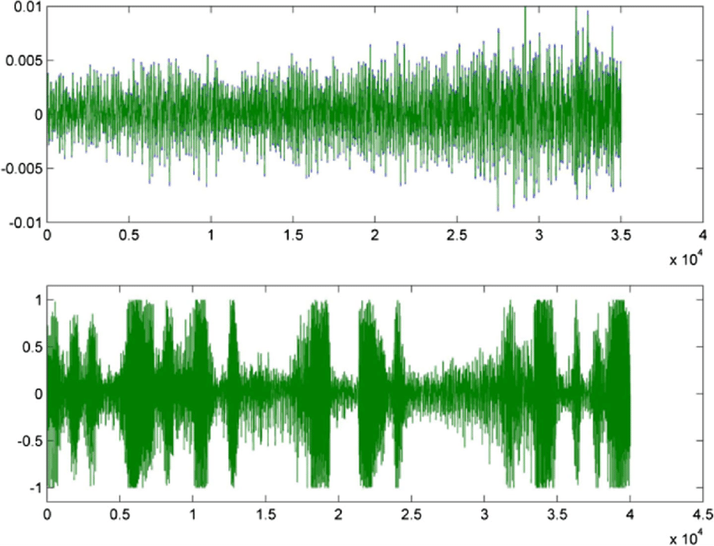
Problem Statement
Automatic Speech Recognition (ASR) models perform poorly when transcribing sung lyrics from real musical recordings
What makes it challenging?
🎸 Background instrumentation masks vocals
🎤 Overlapping or multi-layered vocals
🎛️ Vocal effects (reverb, autotune, delay)
🎶 Pitch variation (melody vs monotone speech)
🎼 Irregular rhythm and stretched phonemes
Music sample waveform
Speech sample waveform
Fernández & Leszczuk. (2017)

Slide 4
Project Goal
Build an end-to-end model to transcribe lyrics directly from mixed music audio

Slide 5
Project Goal
Build an end-to-end model to transcribe lyrics directly from mixed music audio
Project Steps
1st step: train an ASR model on
clean vocals stem of sung lyrics

Slide 6
Project Goal
Build an end-to-end model to transcribe lyrics directly from mixed music audio
Project Steps
1st step: train an ASR model on
clean vocals stem of sung lyrics
2nd step : Fine –tune 1st step model on
mixed audio tracks (with lyrics sung)

Slide 7

Dataset: MUSDB18
Provided under Creative Commons license (via Zenodo)
150 professionally produced mixed audio studio recordings (141 in English)
Each track includes isolated stems: vocals, drums, bass, other, mixture
Predefined train-test split (2:1 ratio)

Slide 8
Lyrics Annotation:
Zenodo Aligned Extension
Dataset: MUSDB18
Provided under Creative Commons license (via Zenodo)
150 professionally produced mixed audio studio recordings (141 in English)
Each track includes isolated stems: vocals, drums, bass, other, mixture
Predefined train-test split (2:1 ratio)
Publicly available
Provides time-aligned lyrics to all MUSDB18 tracks
Lyrics is stored in plain .txt files
Segmented by phrase with start and end timestamps (3-10 sec)
~4,250 total audio-text segments

Slide 9
Data Preparation
Pre-Proccess
Audio split into chunks aligned with annotated lyrics segments
Chunks resampled to 16 kHz mono
Filtered for English tracks with true lyrics (about 30% had “-” lyric)

Slide 10
Data Preparation
Selecting the isolated vocal stems
Audio split into chunks aligned with annotated lyrics segments
Chunks resampled to 16 kHz mono
Filtered for English tracks with true lyrics (about 30% had “-” lyric)
Some EDA
Original dataset = 4,251 segments, After filtering = 2,975 usable segments
1,940 training , 1,035 test
Segment durations: most between 3–12 seconds (mean ≈ 7.2s)
Words per segment: mean ≈ 6.9
Character count distribution: majority between 10 and 80 characters
The most frequent words were “the”, “you”, “I”, “and” and “to”

Slide 11
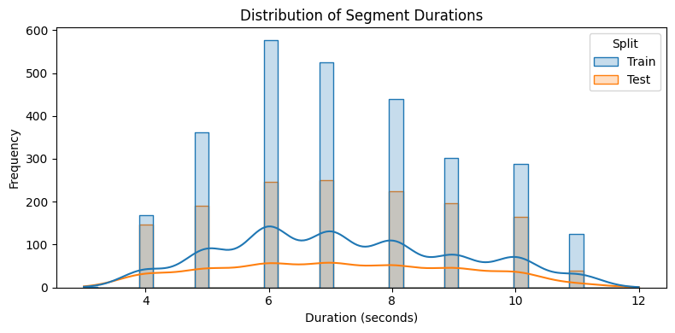
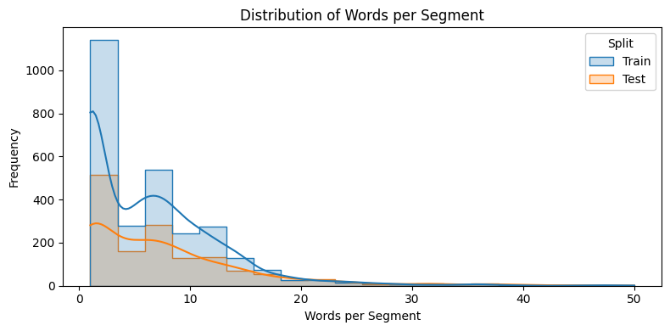
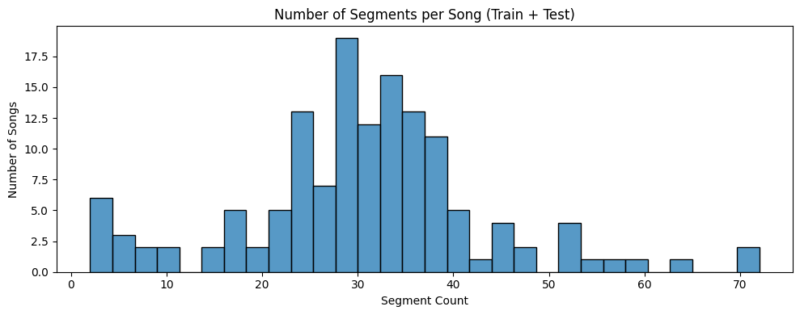
Some EDA

Slide 12

Data Augmentation
Pitch Shifting: Applied transformations of +2 and -2 semitones to simulate vocal variations.
Time Stretching: Modified the tempo by factors of x0.9 and x1.1 to simulate different rhythmic deliveries.
After augmentation – 9,700 train segments
Segment Example - Alexander Ross - Goodbye Bolero_41_46
Original
Pitch +2
Pitch -2
Strech 0.9
Strech 1.1

Slide 13


Slide 14
1st model - CNN + BiLSTM + CTC
Learning acoustic-lyric alignment from
spectrograms using CNN, BiLSTM temporal context and CTC decoding

Slide 15
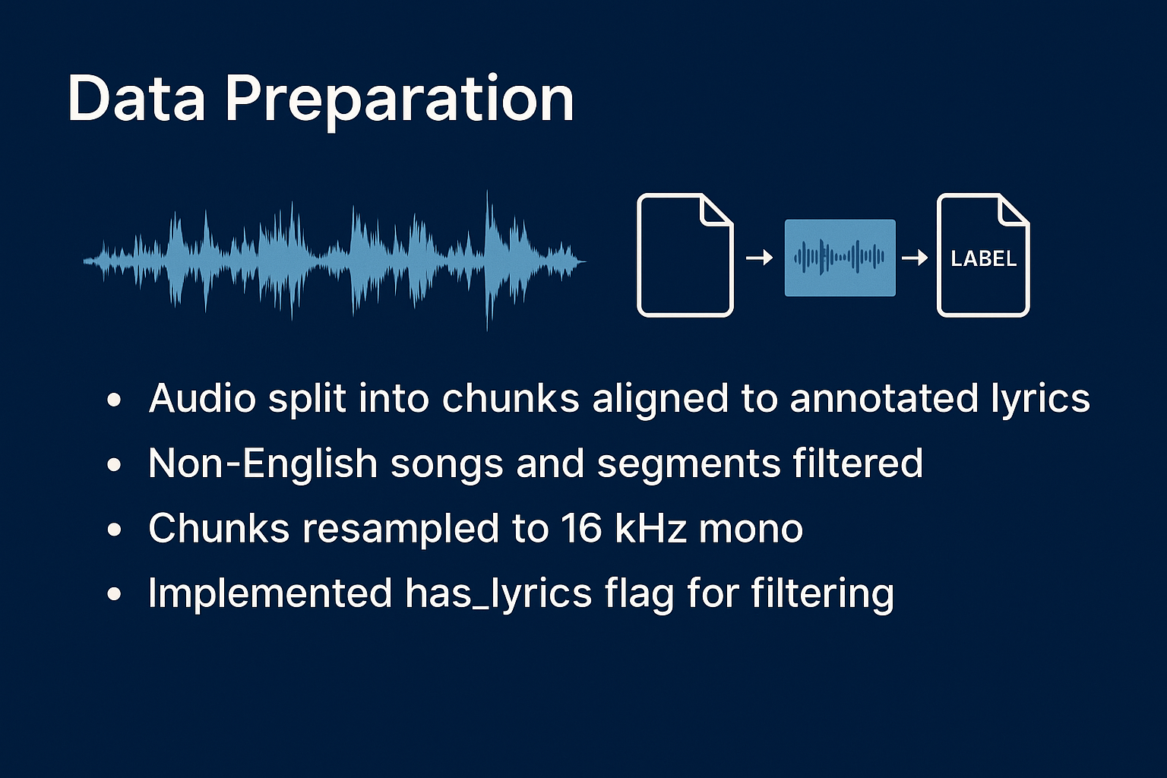
Feature Construction
Audio chunks were transformed into log-Mel spectrograms (80 bands, 20ms hop), resampled to 16kHz mono, and saved as tensors representing time-frequency energy (librosa.feature.melspectrogram).
Labeling
Each lyric segment was lowercased, stripped of punctuation, and tokenized character by character using a custom vocabulary (a–z, space, and blank) for CTC alignment.

Slide 16
Model Architecture
Cnn – BiLSTM – CTC model
Convolutional Neural Network
Three 2D Convolutional Layers
Batch Normalization
Relu Activations
Dropout (0.3)
Max Pooling
Bidirectional LSTM
Two Stacked Bilstm Layers
Final Fully Connected Linear Layer
Projected Outputs To Character Logits
Xavier Initialization
Connectionist Temporal Classification
Align Input With Labels
Decode and Classifies
Compute Negative Log Loss

Slide 17
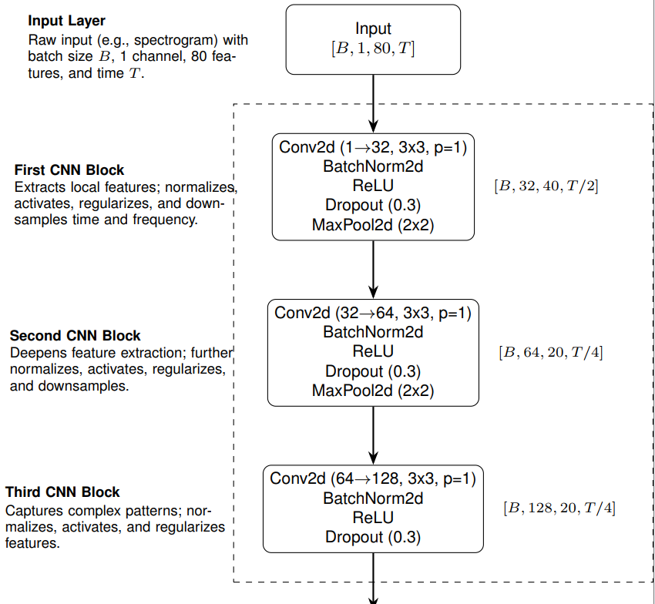

Slide 18
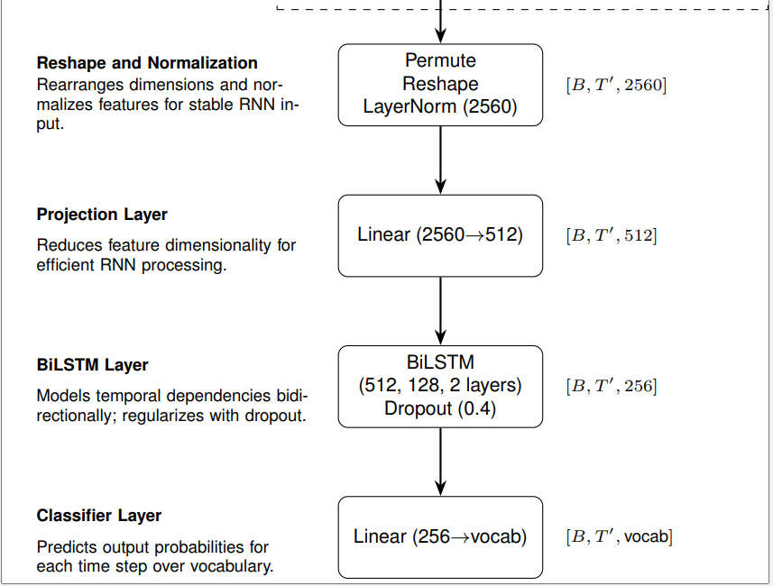
CTC

Slide 19
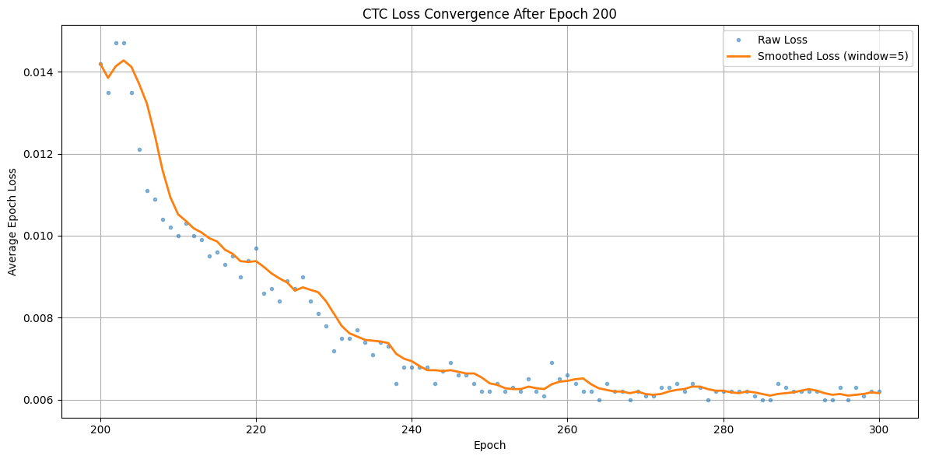
Cnn – BiLSTM – CTC model

Slide 20
Cnn – BiLSTM – CTC model
Predictions on the training data
✅ TRUE: only feel us or you
🔊 PRED: only feel us or youses l lo t yeei ie liou ee
--------------------------------------------------
✅ TRUE: i know the reasons why
🔊 PRED: i know the reasons why boaho t
--------------------------------------------------
✅ TRUE: you crave more
🔊 PRED: you crave more ero s
--------------------------------------------------
✅ TRUE: harder than one
🔊 PRED: harder than one younsed lo
--------------------------------------------------
✅ TRUE: you come up with none little did i think
🔊 PRED: you come up with none little did i think koke wande fre ht
--------------------------------------------------
✅ TRUE: night owl red night promise
🔊 PRED: night owl red night promise ra iosea sone

Slide 21
Cnn – BiLSTM – CTC model
Predictions on test data
✅ TRUE: take on big bite of life to go
🔊 PRED: so io me ao eor woe or o o ons toe t
--------------------------------------------------
✅ TRUE: take an apple please from the front row
🔊 PRED: yoa a o coe oe tor to seer tusassnee
--------------------------------------------------
✅ TRUE: oh soon enough never good enough
🔊 PRED: sos ae toer fome o hs hero to on oe ton chen
--------------------------------------------------
✅ TRUE: inch by inch come on connect the dots
🔊 PRED: dont te oere or mo to oo ta
--------------------------------------------------
✅ TRUE: yeah keep keep keep me in your line of sight squeeze squeeze
🔊 PRED: per ao toe ou fot h tho soe doadane ai thome aon o wont tin ou

Slide 22

Cnn – BiLSTM – CTC model
Predictions on test data
✅ TRUE: take on big bite of life to go
🔊 PRED: so io me ao eor woe or o o ons toe t
--------------------------------------------------
✅ TRUE: take an apple please from the front row
🔊 PRED: yoa a o coe oe tor to seer tusassnee
--------------------------------------------------
✅ TRUE: oh soon enough never good enough
🔊 PRED: sos ae toer fome o hs hero to on oe ton chen
--------------------------------------------------
✅ TRUE: inch by inch come on connect the dots
🔊 PRED: dont te oere or mo to oo ta
--------------------------------------------------
✅ TRUE: yeah keep keep keep me in your line of sight squeeze squeeze
🔊 PRED: per ao toe ou fot h tho soe doadane ai thome aon o wont tin ou

Slide 23
2nd Model –
Transformer CTC: Wav2Vec2-Based Model
Leveraging pretrained audio representations (Wav2Vec2) for character-level transcription with CTC decoding

Slide 24
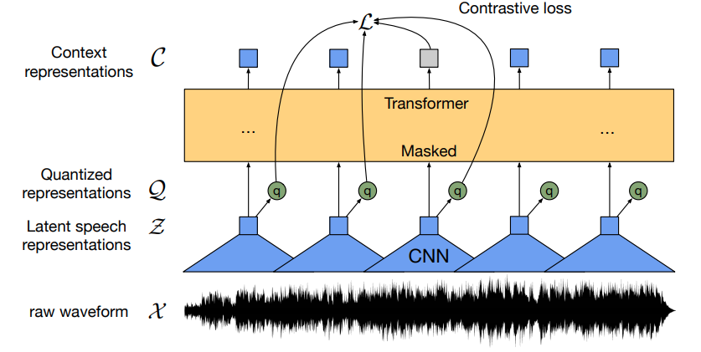
Model Architecture
Wav2Vec2
A convolutional feature encoder for raw waveform processing
A Transformer encoder stack with self-attention
A linear layer projecting encoder outputs to character logits
Connectionist Temporal Classification (CTC) as the loss function
Gris et al., (2022)

Slide 25
Model Fine-Tuning Pipeline
Custom integration of a pretrained CTC Transformer model for lyric transcription
facebook/wav2vec2-base-960h
Collator
Dynamic Padding & Attention Mask Generation For CTC Batches
Tokenizer
Custom Character-level Vocabulary
Processor
Wav2Vec2Processor for waveform + label encoding
Loss Function
Custom CTCLoss (ctc_blank, zero_infinity,
…..)

Slide 26
Model Stability Issues
Problem:
Model keep producing loss=0
Fixing trails:
Vocabulary augmentation: tweak tokens to ensure CTC compability
Model configuration: tweak vocab_size, blank_token_id, pad_token_id, and forced_decoder_ids=None
Weight initialization: lm_head resized and reinitialized using Xavier uniform distribution
CTC loss override: internal CTCLoss layer was replaced
Memory optimizations

Slide 27
Solution:
Load Untrained Wav2vec Model

Slide 28
Solution:
Load Untrained Wav2vec Model
Result:
Step | Training Loss | Validation Loss | Wer | Cer
9296 | 3.592800 | 3.574076 | 1.000000 | 1.000000
9408 | 3.748800 | 3.681134 | 1.000000 | 1.000000
9520 | 3.444700 | 3.581330 | 1.000000 | 1.000000
9632 | 3.533900 | 3.578108 | 1.000000 | 1.000000
9744 | 3.566000 | 3.605809 | 1.000000 | 1.000000
9856 | 3.802900 | 3.700694 | 1.000000 | 1.000000
9968 | 3.513800 | 3.622813 | 1.000000 | 1.000000
10080 | 3.534300 | 3.608435 | 1.000000 | 1.000000
10192 | 3.635300 | 3.633258 | 1.000000 | 1.000000
10304 | 3.441000 | 3.623627 | 1.000000 | 1.000000
10416 | 3.450400 | 3.595749 | 1.000000 | 1.000000
10528 | 3.525100 | 3.586320 | 1.000000 | 1.000000
10640 | 3.457100 | 3.574525 | 1.000000 | 1.000000
10752 | 3.892800 | 3.575264 | 1.000000 | 1.000000
10864 | 3.603000 | 3.578897 | 1.000000 | 1.000000

Slide 29

Solution:
Load Untrained Wav2vec Model
Result:
Step | Training Loss | Validation Loss | Wer | Cer
9296 | 3.592800 | 3.574076 | 1.000000 | 1.000000
9408 | 3.748800 | 3.681134 | 1.000000 | 1.000000
9520 | 3.444700 | 3.581330 | 1.000000 | 1.000000
9632 | 3.533900 | 3.578108 | 1.000000 | 1.000000
9744 | 3.566000 | 3.605809 | 1.000000 | 1.000000
9856 | 3.802900 | 3.700694 | 1.000000 | 1.000000
9968 | 3.513800 | 3.622813 | 1.000000 | 1.000000
10080 | 3.534300 | 3.608435 | 1.000000 | 1.000000
10192 | 3.635300 | 3.633258 | 1.000000 | 1.000000
10304 | 3.441000 | 3.623627 | 1.000000 | 1.000000
10416 | 3.450400 | 3.595749 | 1.000000 | 1.000000
10528 | 3.525100 | 3.586320 | 1.000000 | 1.000000
10640 | 3.457100 | 3.574525 | 1.000000 | 1.000000
10752 | 3.892800 | 3.575264 | 1.000000 | 1.000000
10864 | 3.603000 | 3.578897 | 1.000000 | 1.000000

Slide 30
3rd Model –
OpenAi Whisper Finetuning
Autoregressive Fine-tuning On Clean Vocals Using Openai’s Whisper Encoder-Decoder Model

Slide 31
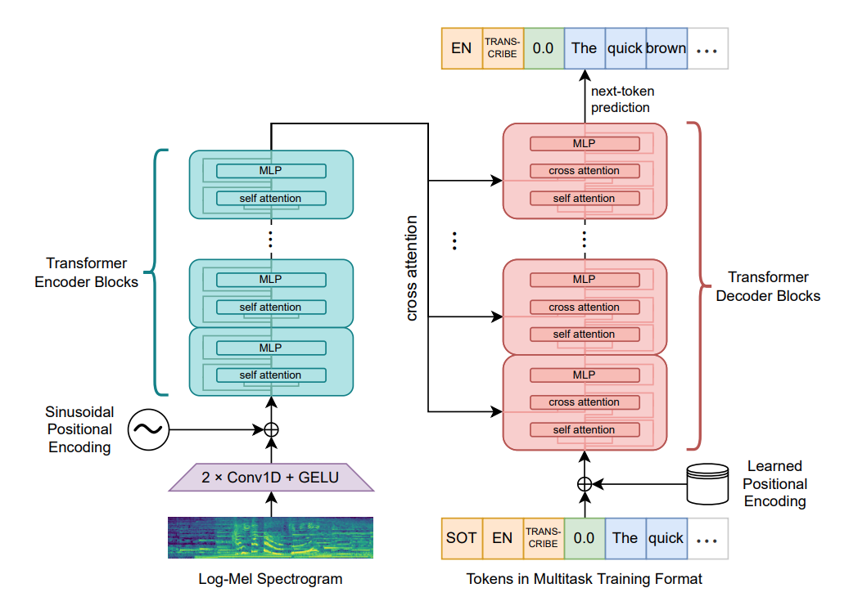
Whisper Model Architecture
Encoder-Decoder Transformer
Encoder: Converts audio into high-level representations using convolution + attention
Decoder: Autoregressively generates text tokens using previously predicted tokens
No CTC: Fully sequence-to-sequence with built-in language modeling
Radford et al., (2023)

Slide 32
Whisper Model
Zero- shot Results:
Clean vocals (2,789 segments): WER = 0.456, CER = 0.932
Mixed audio (1,940 segments): WER = 0.665, CER = 0.512
WER (Word Error Rate)
= (S+D+I​)/N
Where:
S = number of substitutions
D = number of deletions
I = number of insertions
N = number of words in the reference
Fine-Tuning Procedure
Preprocessing Configuration
Added <eos> token to targets to improve termination control
Set language="en" and task="translate" in Whisper processor
Enabled return_attention_mask=True to ensure proper handling of padding during training
Passed attention_mask to address token ambiguity
Ran a 500-step validation to confirm configuration
Total 9700 data points

Slide 33
Whisper Model Training
Training Details:
Total training steps: 2000
Training/Validation split: 90% train / 10% validation
Epochs: Determined by data size and batch size
Batch size: 8 per device (fp16 enabled)
Validation frequency: Every 500 steps
Run executed on A100 GPU (Google Colab)
Observations:
Validation WER and CER consistently improved through step 1500
Overfitting observed by step 2000 (WER + val-loss increased)
Final training loss: 0.0249

Slide 34
Whisper Model
Vocals Only Results
Final Evaluation on Test Set:
WER: 0.088
CER: 0.085
Compare with off-the-shelf Whisper: WER: 0.456
CER: 0.332

Slide 35
Whisper Model
Vocals Only Results
Mixed audio Results
Final Evaluation on Test Set:
WER: 0.088
CER: 0.085
Compare with off-the-shelf Whisper: WER: 0.456
CER: 0.332
Final Evaluation on Test Set:
WER: 0.11
CER: 0.095
Compare with off-the-shelf Whisper: WER: 0.665
CER: 0.512

Slide 36
Whisper Model Prediction (test)
The Best predictions (WER: 0.000 CER: 0.000):
GT: for the time of my life
PR: for the time of my life
------------------------------------------------------------
GT: where will my heart come back to life
PR: where will my heart come back to life
------------------------------------------------------------
GT: sun is hiding beautiful black eyes
PR: sun is hiding beautiful black eyes
------------------------------------------------------------
GT: she met him last year at the local
PR: she met him last year at the local
------------------------------------------------------------
GT: i know that you can find me when i'm lost when i'm lost
PR: i know that you can find me when i'm lost when i'm lost
And The Worst:
GT: bulldozer
PR: burn those who are left behind burn those who are left behind burn those who are left behind burn those who are left behind burn those who are left behind burn those who are left behind burn those who are left behind burn those who are left behind burn those who are left behind burn those who are left behind burn those who are left behind burn those who are left behind burn those who are left behind burn those who are left behind burn those who are left behind burn those who are left behind burn those who are left behind burn those who are left behind burn those who are left behind burn those who are left behind burn those who are
WER: 1.24 CER: 1.7
------------------------------------------------------------
GT: ha
PR: oh uh uh uh uh uh uh uh uh uh uh uh uh uh uh uh uh uh uh uh uh uh uh uh uh uh uh uh uh uh uh uh uh uh uh uh uh uh uh uh uh uh uh uh uh uh uh uh uh uh uh uh uh uh uh uh uh uh uh uh uh uh uh uh uh uh uh uh uh uh uh uh uh uh uh uh uh uh uh uh uh uh uh uh uh uh uh uh uh uh uh uh uh uh uh uh uh uh uh uh uh uh uh uh uh uh uh uh uh uh uh uh uh uh uh uh uh uh uh uh uh uh uh uh
WER: 1.24 CER: 1.85

Slide 37


